Slide 1
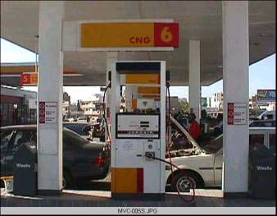
SNG LOGISTICS Promising New Era Use of CNG for SNG Fleet Vehicles
.. Promising New Era
Emmanuel Akefe
Senior Metering Analyst/Logistics Co-ordinator

Slide 2
INTRODUCTION CNG Safety
Objectives
To establish suitability of using Compressed Natural Gas (CNG) as an alternative fuel to AGO/PMS for SNG Fleet Vehicles
Due to its gaseous nature, CNG is thought to have greater fire/explosion risk than gasoline.
Rigourously tested evidence proves otherwise
Safety provisions for CNG fuel system:
Very dense steel/fibre tanks (hence the relatively high cost).
Auto-ignition temperature of CNG higher than petrol or diesel.
Relatively narrow flammability range for CNG.
Firm connections and valves.
Pressure relief devices (PRD).
Shell Downstream has developed operations and safety guides that bring the risk down to ALARP.
International Guidelines for CNG operations:
SAE J616: Recommended Practice for compressed natural gas vehicle fuel, Issued 1994-02.
ISO 15403:2000: Natural gas, Designation of the quality of natural gas for use as compressed fuel for vehicles.
CARB CCR, title 13, section 2292.5: Specification for Compressed Natural Gas (Section Alternative Motor Fuels).
NZS 5442, 1999.01.26, Natural Gas specification.
CASE FOR CHANGE
SNG is Natural Gas orientated company
SNG spent about NGN8.3 Million on AGO/PMS Annually
Greenhouse Gas emissions from operations
DESIRED STATE
Safety
The Future of Fuel
Reduced Cost of Fuel
Reduced Carbon Footprint
Reduced Maintenance Cost
Longer Engine Vehicle Life

Slide 3
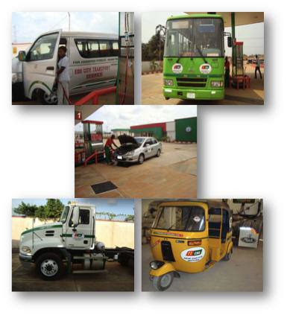
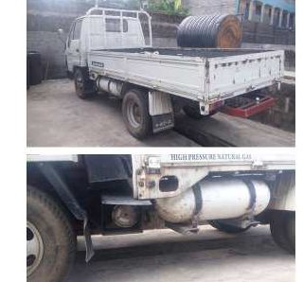
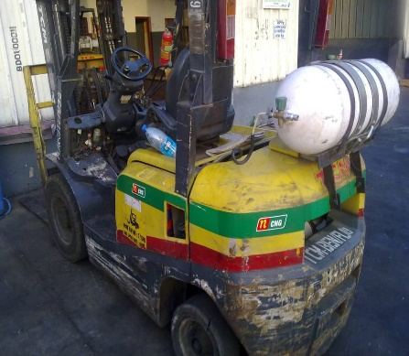
CNG: What is available CNG Vs AGO/PMS
Many companies are now using CNG for their vehicles
(DANGOTE, SAHARA ENERGY, OANDO etc.)
There are over 10 CNG solution providers in Nigeria e.g Peugeot Auto of Nig. (PAN) in Kaduna State, Totalsupport Energy Ltd in PHC, GGL, etc. for Kaduna St. Govt; organizations in Ghana, etc.
Green Gas Limited CNG filling station at Ibafo has the capacity to dispense up to 4000 vehicles per day.
Over 6000 vehicles are now running on CNG in Benin city with 8 CNG filling stations, Warri in Delta State, Okene in Kogi State and conversion rate growing daily championed by NNPC/Green Gas Ltd. (NIPCO JV).
- Environmentally Friendly.
- Lower maintenance cost than Petrol/diesel Vehicle.
- Increases the life of lubricating oils as it mixes easily and evenly in air.
- Less pollution and more efficiency.
- It is cheaper than AGO/PMS.
- CNG tank require high storage space.
- CNG made engine vehicles are costly more than other fuel engine of the same car.
- Limited availability of CNG filling stations as compare to AGO/PMS.
PROS
CONS

Slide 4
Saving Analysis 2019 Fuel Consumption/SNG CNG Strategy
Replace AGO/PMS as primary Fuel for two Vehicles operating from NSE Ikeja office/PRMS Ota
Replace AGO/PMS for 50% Vehicles in NSE/PRMS Ota
Replace AGO/PMS for All Vehicles in the West and East.
Toyota Car
Item | Value
Distance travelled per Month (Km) | 1824
Fleet size | 8
Conversion cost per vehicle (NGN) | 250,000.00
Cost of Petorl/Km (NGN) | 20.00
Cost of CNG/Km (NGN) | 9.50
Cost based on 100% PMS for 4 yrs. life span (NGN) | 14,008,320.00
Cost based on CNG for 4 yrs. life span (NGN) | 6,653,952.00
Total saving for Fleet (4 yrs. life span) | 7,354,368.00
Total conversion cost for 8 Cars (NGN) | 2,000,000.00
Total saving for Fleet after conversion cost | 5,354,368.00
Pay back period | 8 Months
Location | PMS (Litres) | AGO (Litres) | Total
Lagos | 19,370 | 319 | 19,689
Ota | 19,193 | 10,825 | 30,018
Total | 38,563 | 11,144 | 49,707
Toyota Pick-Up
Item | Value
Diesel consumed per Month (Litres) | 260
Fleet size | 12
Conversion cost per vehicle (NGN) | 400,000.00
Cost of Diesel/Litre (NGN) | 225.50
Cost of CNG/cubic meter (NGN) | 95.00
Cost based on 100% AGO for 5 yrs. life span (NGN) | 42,213,600.00
Cost based on CNG & AGO for 5 yrs. life span (NGN) | 28,777,320.00
Total saving for Fleet (5 yrs. life span) | 13,436,280.00
Total conversion cost for 12 Pick-Ups (NGN) | 4,800,000.00
Total saving for Fleet after conversion cost | 8,636,280.00
Pay back period | 1yr, 10Months
PHASE 1
PHASE 2
PHASE 3
Retrofit of the two (2) Vehicles
Operates a car at NSE
Operates a Pickup at PRMS Ota
Operates the 2 vehicles as
dual fuel AGO/PMS & CNG
Reduce vehicles AGO/PMS
consumption by 50%.
Carry out economics on use
of CNG for all vehicles.
Reduce AGO/PMS in the
organization by significant amount.
Retrofit of the 50% vehicles
Operates 50% at NSE/PRMS
Reduce vehicles AGO/PMS
consumption 80%.

